Slide 1
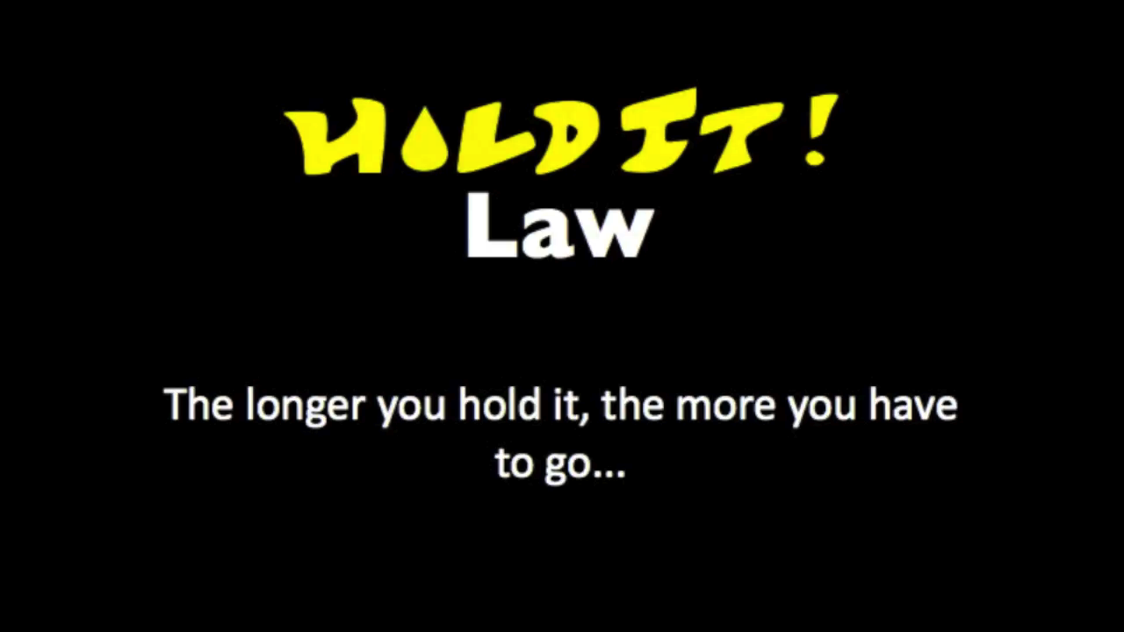

Slide 2
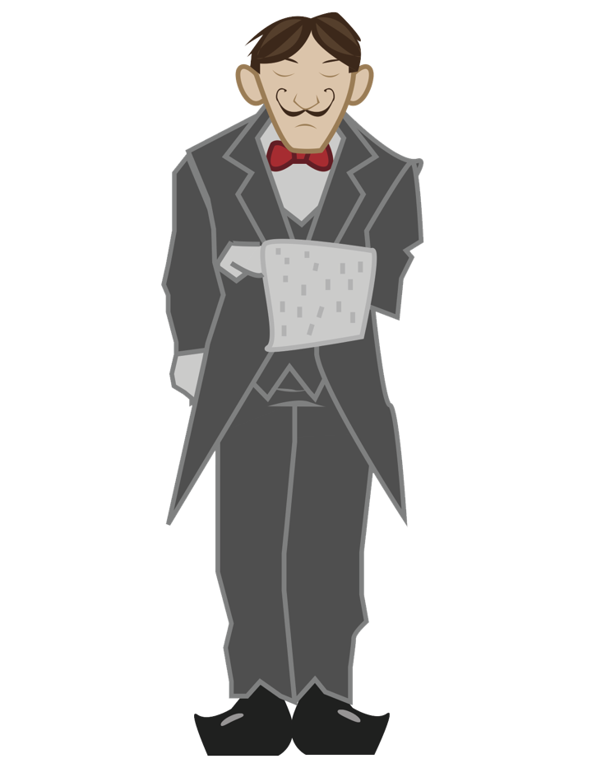
Instructions
To play Hold It! one must simply tap one of the "gentlemen" waiting in line and then one taps the facility to which one wishes them sent. Some interesting characters visit the W.C. so one is encouraged to visit the following descriptions.
Always go to the bathroom when you have a chance.
– King George V

Slide 3

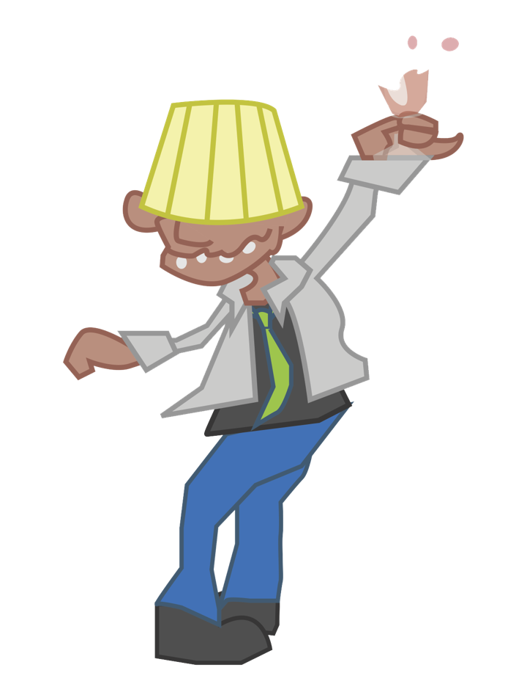

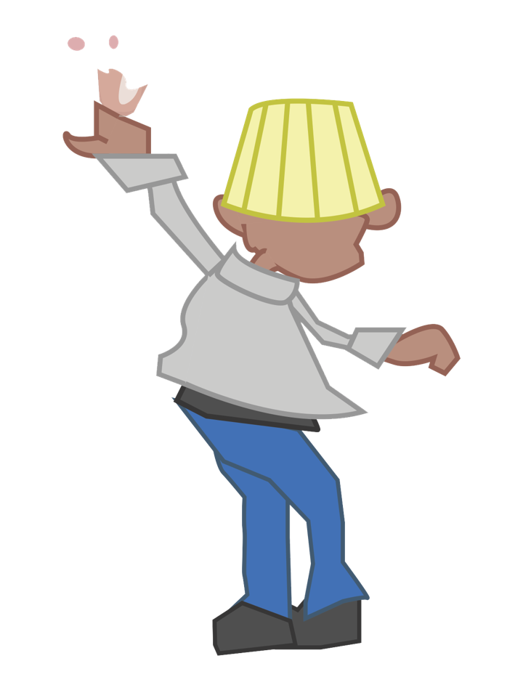
The Drunk
The Drunk doesn’t care where you want him to go. He’s gotta go to the bathroom and he’s gonna go right away. Just pray he doesn’t vomit in the sink.
It takes only one drink to get me drunk. The trouble is, I can't remember if it's the thirteenth or the fourteenth.
– George Burns
In The Can Games

Slide 4
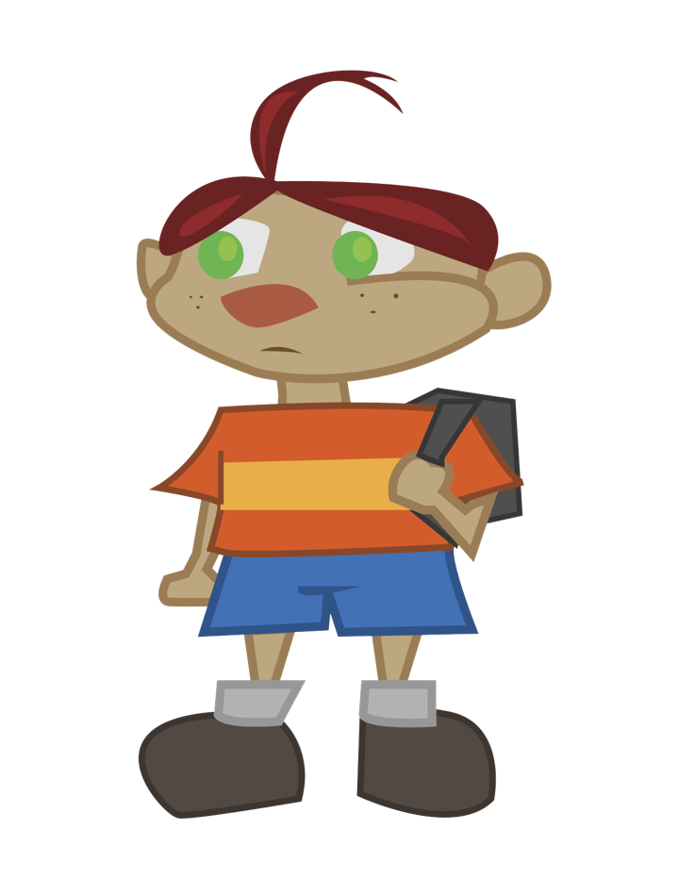


The Kid
The Kid may not be that tall but he knows how to work a toilet alright. The Kid isn’t that tall so make sure to send him to a Lowboy or a stall.
You ain't cool, unless, you pee your pants! Everybody my age pee their pants; it's the coolest!
– Adam Sandler (Billy Madison)
In The Can Games

Slide 5
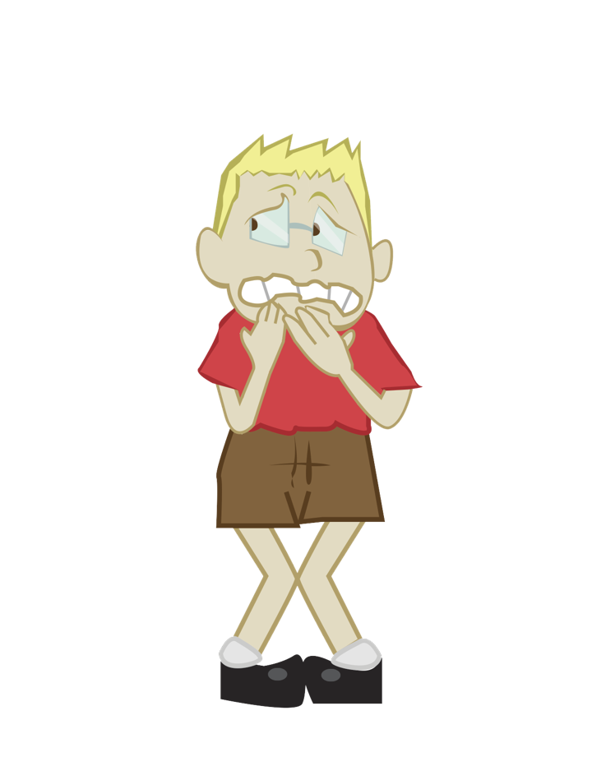
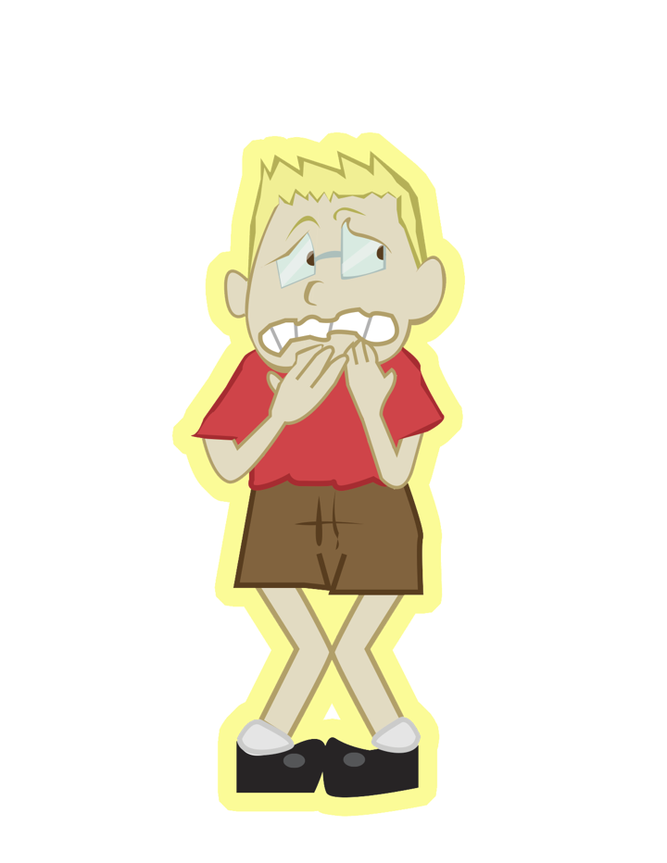
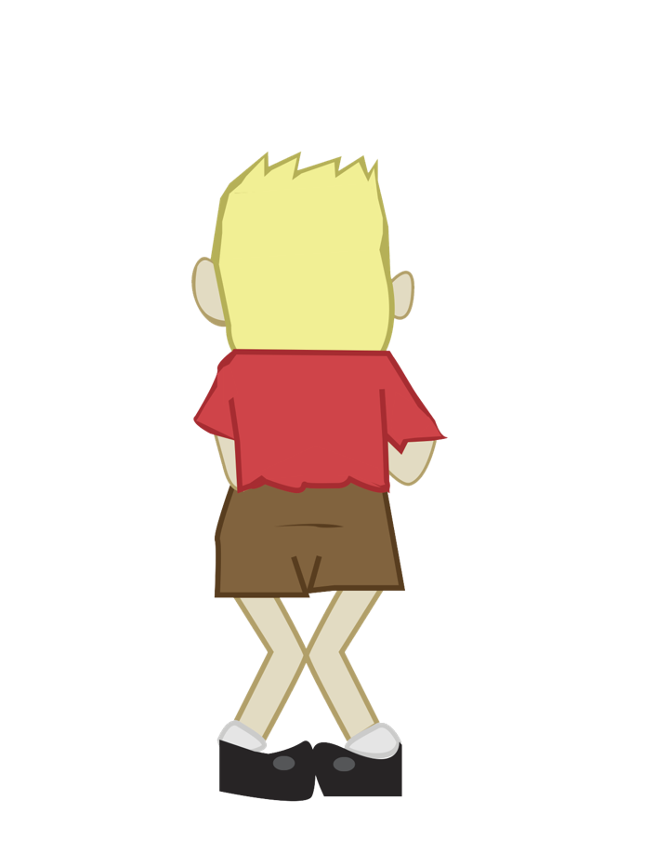
Nerves
Nerves doesn’t have a problem. You have a problem so just don’t stand so close. Nerves doesn’t pee when he’s next to anybody.
For marriage to be a success, every woman and every man should have her and his own bathroom. The end.
– Catherine Zeta-Jones
In The Can Games

Slide 6
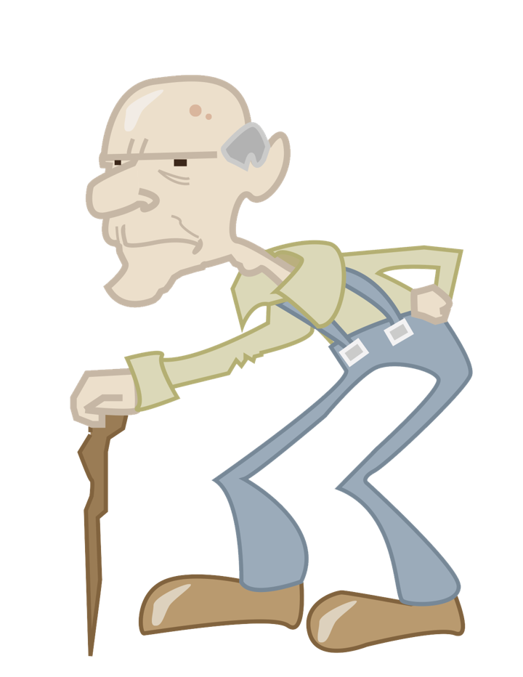
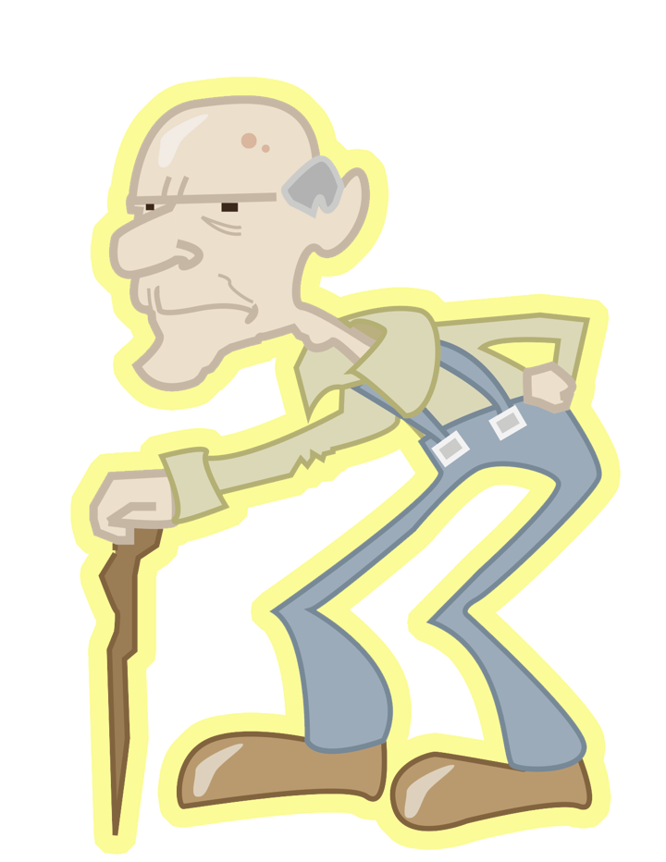
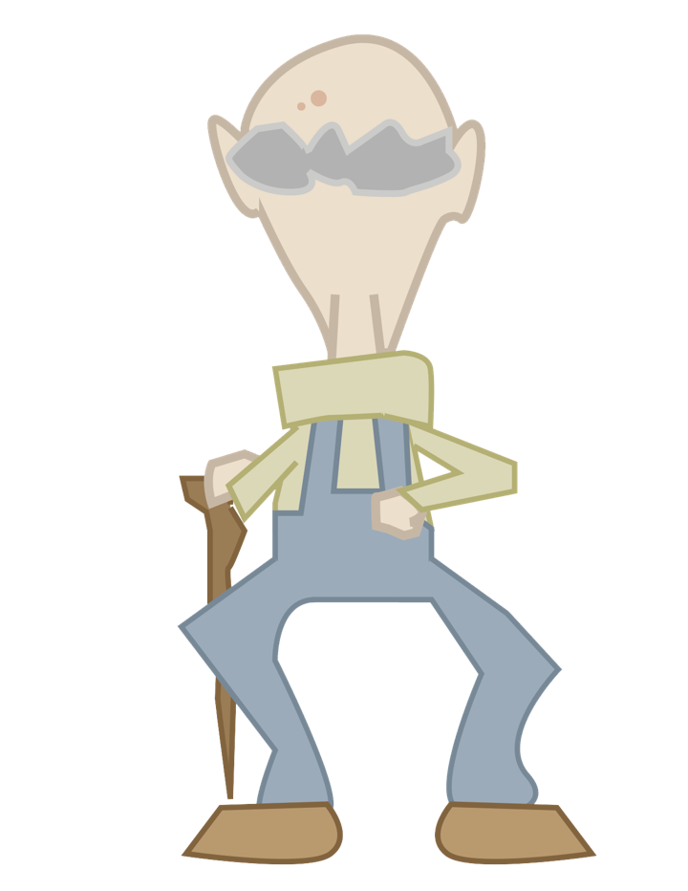
Old Man
When the Old Man was your age he had to use an outhouse. Show some respect kid. The Old Man is a little slow and has to go a bit more often then he used to.
At a formal dinner party, the person nearest death should always be seated closest to the bathroom.
– George Carlin
In The Can Games

Slide 7
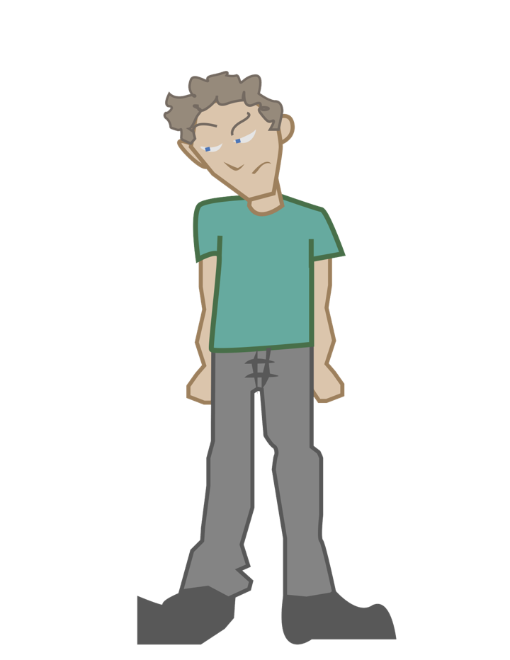
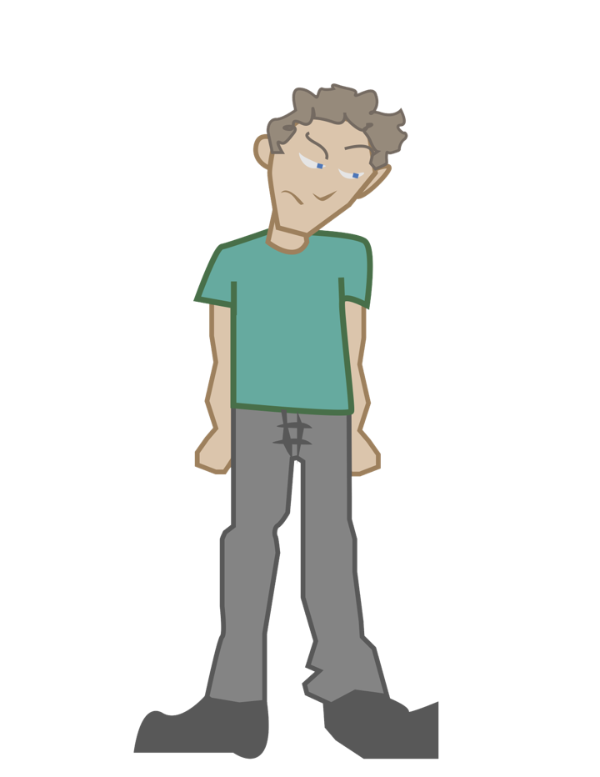
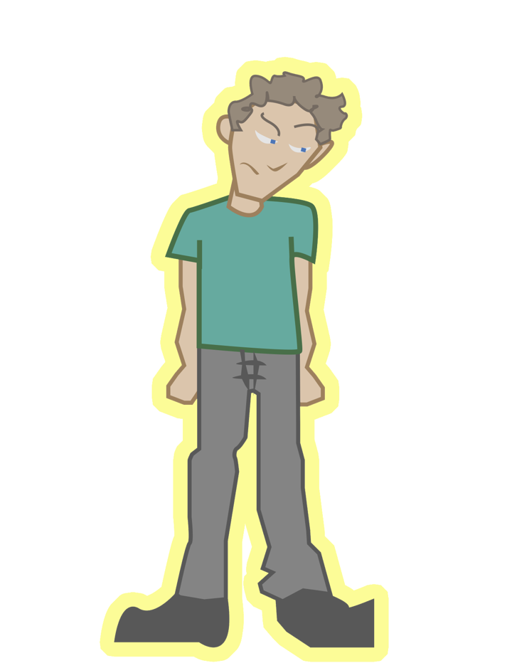
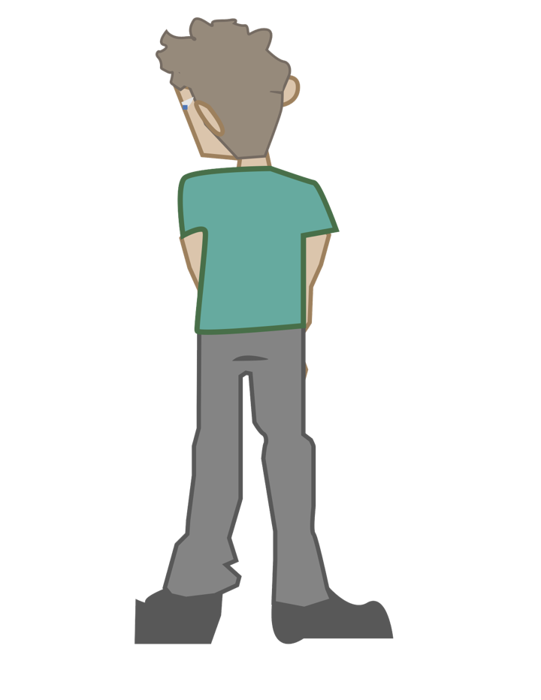
The Peeker
The Peeker is just scoping out the competition, seeing who can measure up. No one else will go next to the Peeker.
Never confuse the size of your paycheck with the size of your talent.
– Marlon Brando
In The Can Games

Slide 8
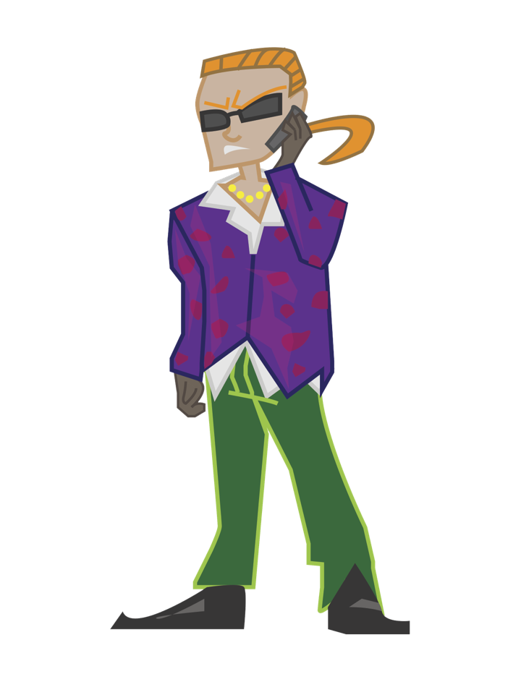

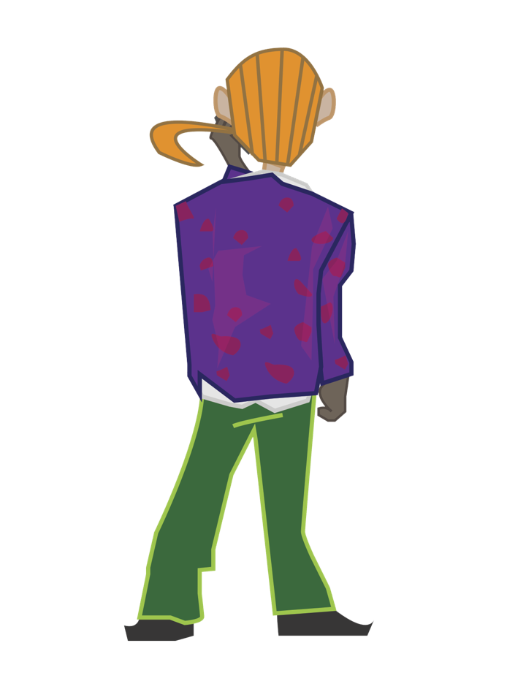
Phone Jerk
The Phone Jerk is an important person. He tweets in the bedroom and takes calls at the theater. Make his life hell for extra points.
Using your cellphone or laptop in the bathroom is perfectly acceptable–just rinse and lather afterwards!
– Anonymous
In The Can Games

Slide 9
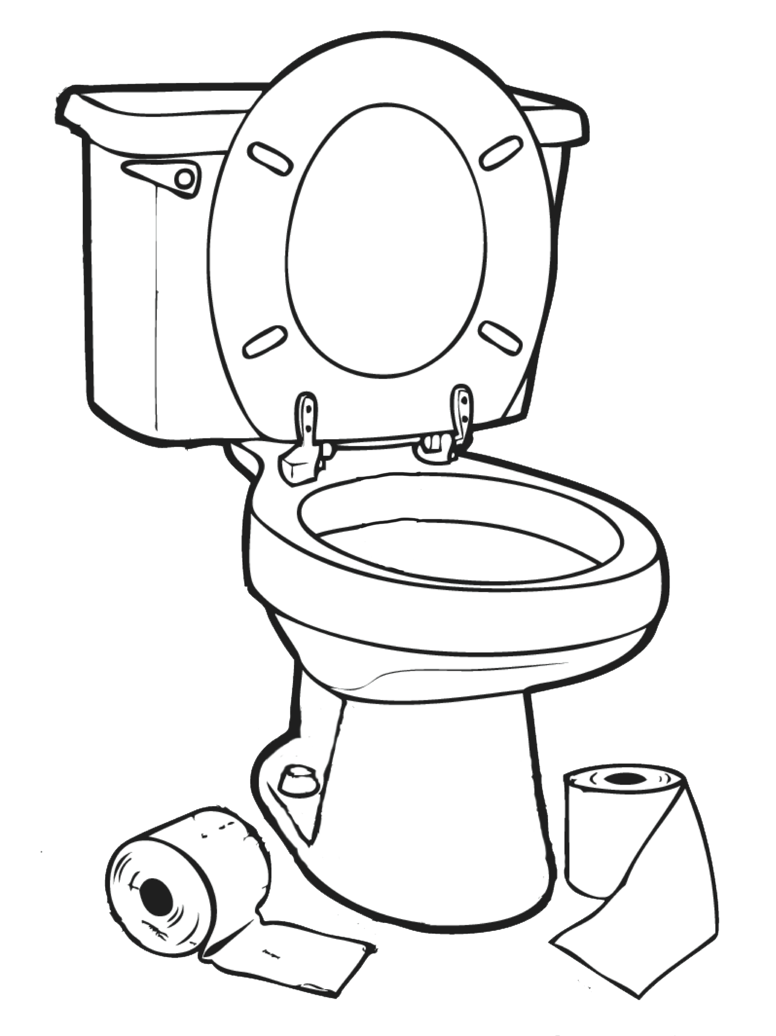
Thank You!
In The Can Games

